Slide 1

FORKATHON: FRESHERS HACKATHON 2026
Team KUET_Titanium
Presented by ForkedArch — Powered by XtendArena

Slide 2
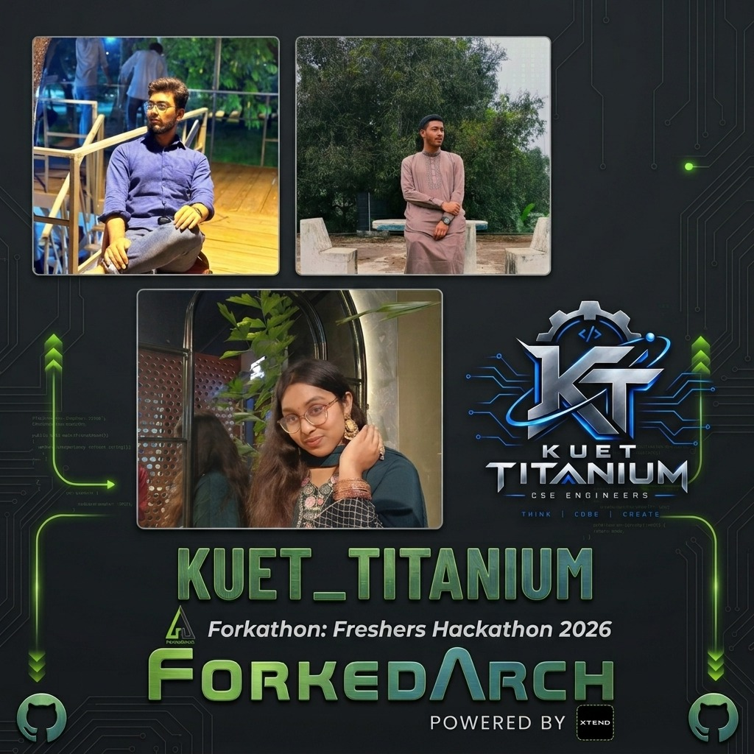
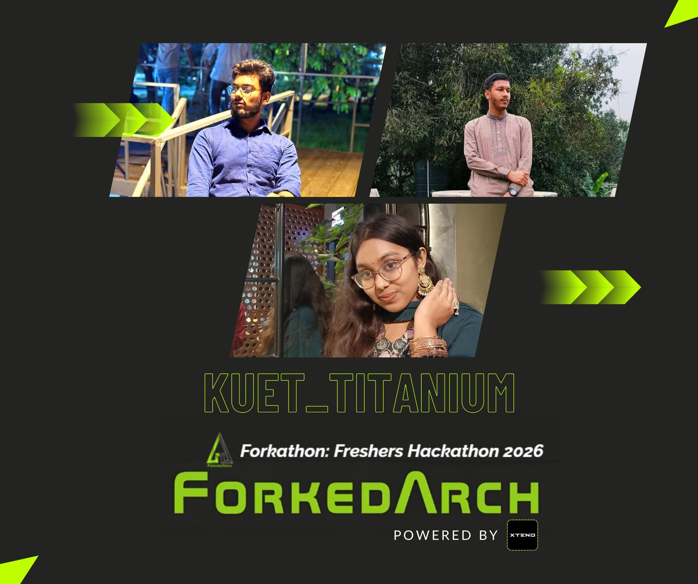
MEET THE TEAM
KUET_Titanium
Designed by
Mira • Ahnaf • Tahsin

Slide 3

FORKATHON: FRESHERS HACKATHON 2026
The Student Who
Knows Everything
A trust-aware, self-updating memory for campus knowledge
Team KUET_Titanium
Presented by ForkedArch • Powered by XtendArena

Slide 4
The Problem
Every campus has that one senior who knows everything.
“Where do I submit this form?”
Then, They Graduate
“Which room is the lab in?”
Years of hard-earned, practical knowledge walk out the door with them. The next batch starts from zero — repeating the same confusion, asking the same questions, making the same mistakes their seniors already solved.
“Where can I find previous question papers?”
“Who do I even contact about this?”
The real question: why not build a system that captures, verifies, and passes this knowledge down automatically?
Knowledge is not just academic — it spans facilities, procedures, resources, tips, locations, and events. And it is not all equally reliable, current, or useful.
KUET_Titanium • Forkathon: Freshers Hackathon 2026
4

Slide 5



Breaking Down the Core Problem
It's a classic case of institutional amnesia.
Scattered Information
No Knowledge Retention
Trust & Validity Gap
Knowledge lives nowhere official — fragmented across temporary group chats, word of mouth, and individual memory.
When experienced seniors graduate, campus wisdom resets back to zero for the next batch.
Information ages. A tip from three years ago may be outdated, and reliability varies wildly by source.
The inefficiency tax: every new generation pays the price of making the same avoidable mistakes, simply because past learnings were never preserved.
KUET_Titanium • Forkathon: Freshers Hackathon 2026
5

Slide 6


Who Feels This Every Semester
Students
Faculty & Staff
Especially freshers & juniors
The other side of the same problem
They waste endless hours, energy, and sanity navigating basic campus bureaucracy, finding obscure resources, or figuring out how things actually work — time that should go toward projects, studying, and innovating.
They end up answering the same repetitive procedural questions dozens of times every single semester — simply because students have nowhere official to check.
KUET_Titanium • Forkathon: Freshers Hackathon 2026
6

Slide 7

OUR SOLUTION
An offline-first Android app that acts as a living, evolving memory for the campus community.
Practical knowledge is captured once, verified by the community, and automatically passed down to every new batch — no matter who graduates.
Built for Forkathon: Freshers Hackathon 2026 — Team KUET_Titanium

Slide 8





Core Objectives
Offline-First App
Flexible Knowledge DB
Searchable Chunks
Works seamlessly with no signal, and syncs automatically once connectivity returns.
Handles diverse data — locations, contacts, warnings, steps — without a rigid schema.
Bite-sized, tagged entries enable high-precision, instant search results.
Guided Roadmaps
Validation & Lifespan
Contribution Scores
Complex processes laid out as clear Step 1 → Step 2 → Step 3 journeys.
Entries track freshness; aging info is flagged for community re-verification.
Trust scores and level tiers give weight to high-integrity contributors.
KUET_Titanium • Forkathon: Freshers Hackathon 2026
8

Slide 9



How It Works
From a senior's tip to permanent, searchable campus knowledge.
1
2
3
4
5
Capture
Organize
Verify
Search & Guide
Pass It On
Students & seniors submit tips, notes, and guides via a simple form.
Entries are tagged by category in a flexible local database.
Lifespan markers flag aging entries; peers confirm or correct them.
Instant search or a step-by-step roadmap for common problems.
Contribution earns levels — the knowledge base keeps growing.
KUET_Titanium • Forkathon: Freshers Hackathon 2026
9

Slide 10



Architecture (Concept)
A simple, offline-capable flow from student to synced knowledge base.
User
Frontend
Backend / API
Student searching, submitting, or browsing knowledge
Offline-capable Android UI
Request handling, validation, scoring logic
Database
External Services
Local/synced storage holding the knowledge base for offline access
Drive links for documents; sync & validation endpoints when online
Full architecture diagram to be finalized once the tech stack is locked in.
KUET_Titanium • Forkathon: Freshers Hackathon 2026
10

Slide 11




Known Limitations
Honest constraints of the current scope — not blockers, but boundaries.
Limited online sync
Validation needs connectivity
Quality depends on contributors
No conflict resolution yet
Devices may temporarily hold different versions until sync happens.
Offline, the app relies on last-known validity status.
Accuracy relies on students/seniors, not an official authority.
No process yet for resolving conflicting offline edits.
Scope: CSE students first
Keyword-based search
Gamification unproven
Relies on external links
Other departments aren't covered in this version.
Matches terms, not intent — vague queries may miss results.
Optional leaderboard with no guaranteed long-term effect.
Heavy content (reports, papers) is inaccessible offline.
KUET_Titanium • Forkathon: Freshers Hackathon 2026
11

Slide 12
Building a Trust-Aware, Self-Updating
Memory for Campus
So that when the senior who knows everything graduates — everything they knew stays behind.
Team KUET_Titanium
Forkathon: Freshers Hackathon 2026 — Presented by ForkedArch — Powered by XtendArena

